Slide 1
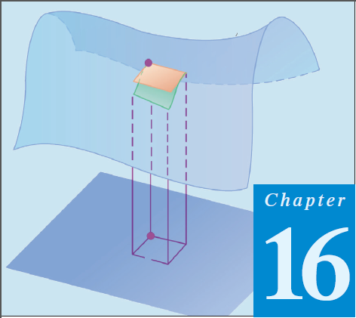
12
Thomas Calculus 12th (Chapter 16)
Calculus 9rd, Dale Varberg, Edwin Purcell and Steve Rigdon (C.14)
Stokes’ Theorem
Samuel Lukas

Slide 2
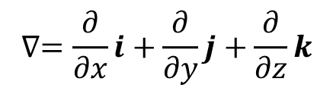
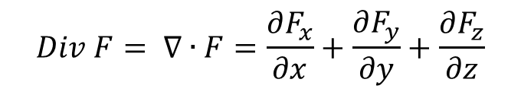
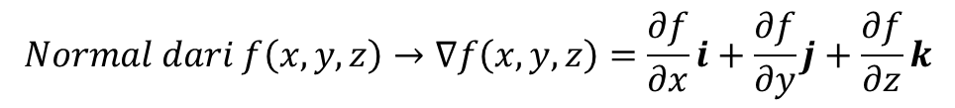
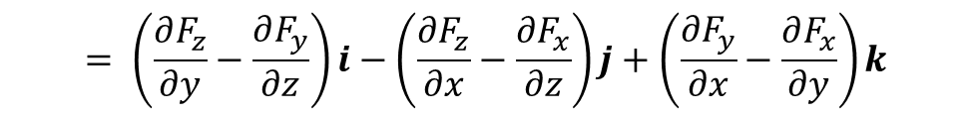
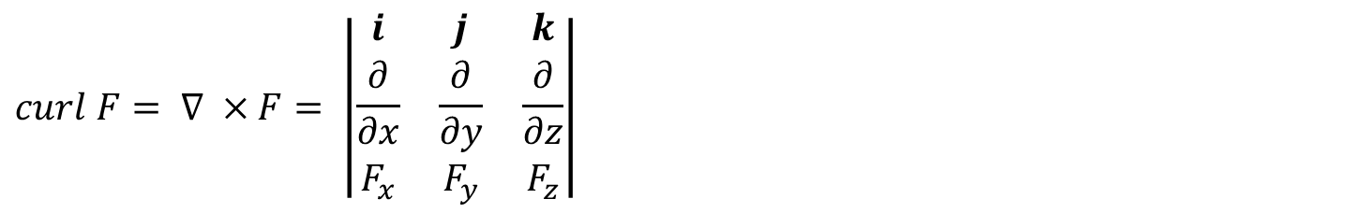
Review
$$Normal dari f\left(x,y,z\right)→∇f\left(x,y,z\right)=\frac{∂f}{∂x}i+\frac{∂f}{∂y}j+\frac{∂f}{∂z}k$$
$$∇=\frac{∂}{∂x}i+\frac{∂}{∂y}j+\frac{∂}{∂z}k$$
$$Div F= ∇∙F=\frac{∂F_{x}}{∂x}+\frac{∂F_{y}}{∂y}+\frac{∂F_{z}}{∂z}$$
$$curl F= ∇ ×F= \left|\begin{matrix}i & j & k \\ \frac{∂}{∂x} & \frac{∂}{∂y} & \frac{∂}{∂z} \\ F_{x} & F_{y} & F_{z}\end{matrix}\right|$$
$$= \left(\frac{∂F_{z}}{∂y}−\frac{∂F_{y}}{∂z}\right)i−\left(\frac{∂F_{z}}{∂x}−\frac{∂F_{x}}{∂z}\right)j+\left(\frac{∂F_{y}}{∂x}−\frac{∂F_{x}}{∂y}\right)k$$

Slide 3
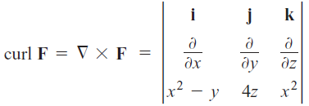
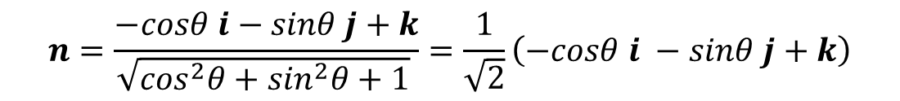


Examples 1
Find the unit normal of $z=\sqrt{x^{2}+y^{2}}$ at coordinate $(x,y,z)$
$f\left(x,y,z\right)=$ $z −\sqrt{x^{2}+y^{2}}→∇f=−\frac{1}{2} \frac{2x}{\sqrt{x^{2}+y^{2}}}i−\frac{1}{2} \frac{2y}{\sqrt{x^{2}+y^{2}}}j+k$
In the form of polar coordinate than
$$∇f=−cosθ i−sinθ j+k$$
$$n=\frac{−cosθ i−sinθ j+k}{\sqrt{\cos^{2}θ+\sin^{2}θ+1} }=\frac{1}{\sqrt{2}}\left(−cosθ i −sinθ j+k\right)$$
Find the curl of $F=\left(x^{2}−y\right)i+4z j+x^{2}k$
$$∴∇×F=−4i−2xj+k$$

Slide 4

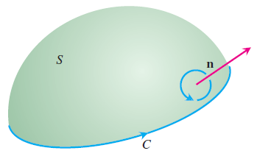
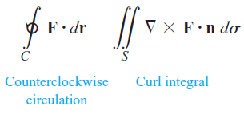
Stokes’ Theorem

Slide 5






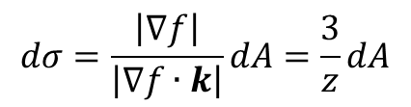
Example 2
Solution by Changing the system to the polar coordinate system we get
$$dσ=\frac{\left|∇f\right|}{\left|∇f∙k\right|}dA=\frac{3}{z}dA$$

Slide 6
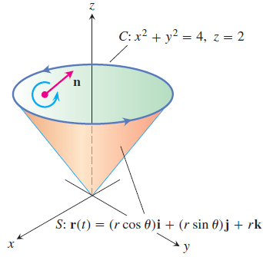


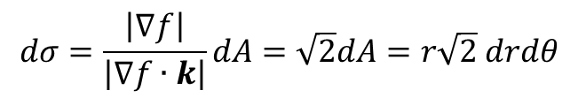
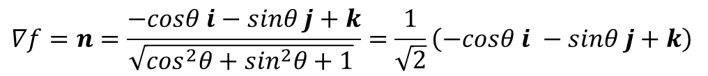
$$∇f=n=\frac{−cosθ i−sinθ j+k}{\sqrt{\cos^{2}θ+\sin^{2}θ+1} }=\frac{1}{\sqrt{2}}\left(−cosθ i −sinθ j+k\right)$$
$$dσ=\frac{\left|∇f\right|}{\left|∇f∙k\right|}dA=\sqrt{2}dA=r\sqrt{2} drdθ$$

Slide 7
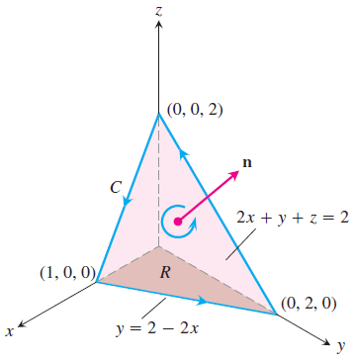

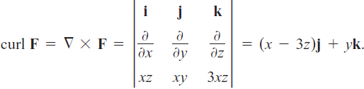



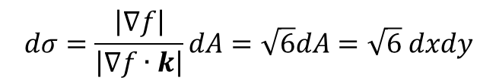
$$dσ=\frac{\left|∇f\right|}{\left|∇f∙k\right|}dA=\sqrt{6}dA=\sqrt{6} dxdy$$

Slide 8



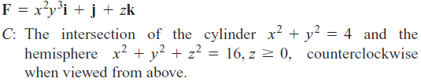
Exercises 1
In Exercises 1 – 4, use the surface integral in Stokes’ Theorem to calculate the circulation of the field F around the curve C in the indicated direction.
1.
2.
3.
4.

Slide 9
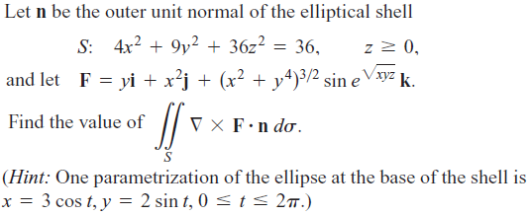
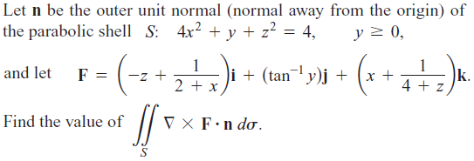
5.
6.

